Slide 1


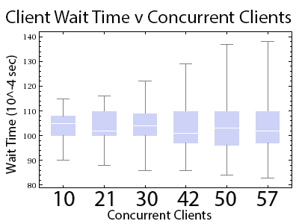
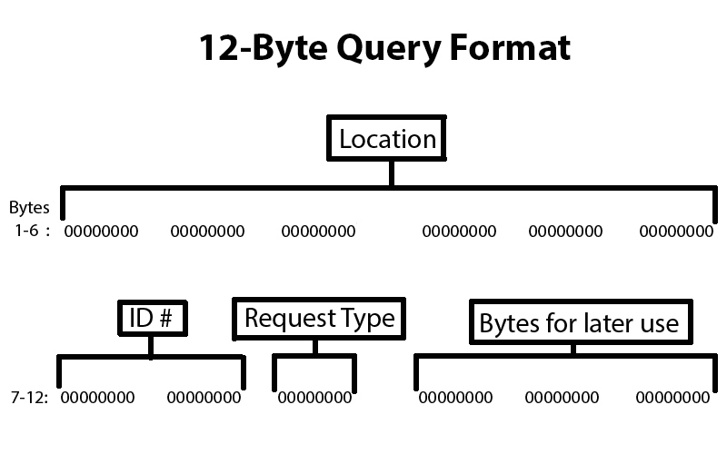
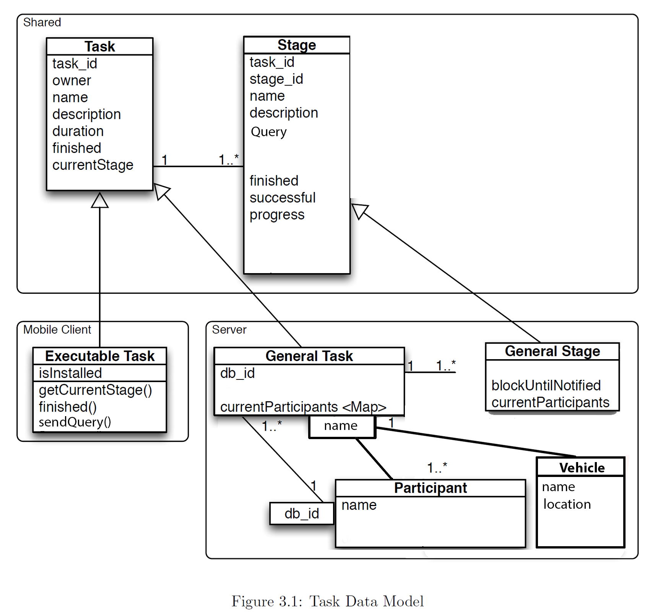
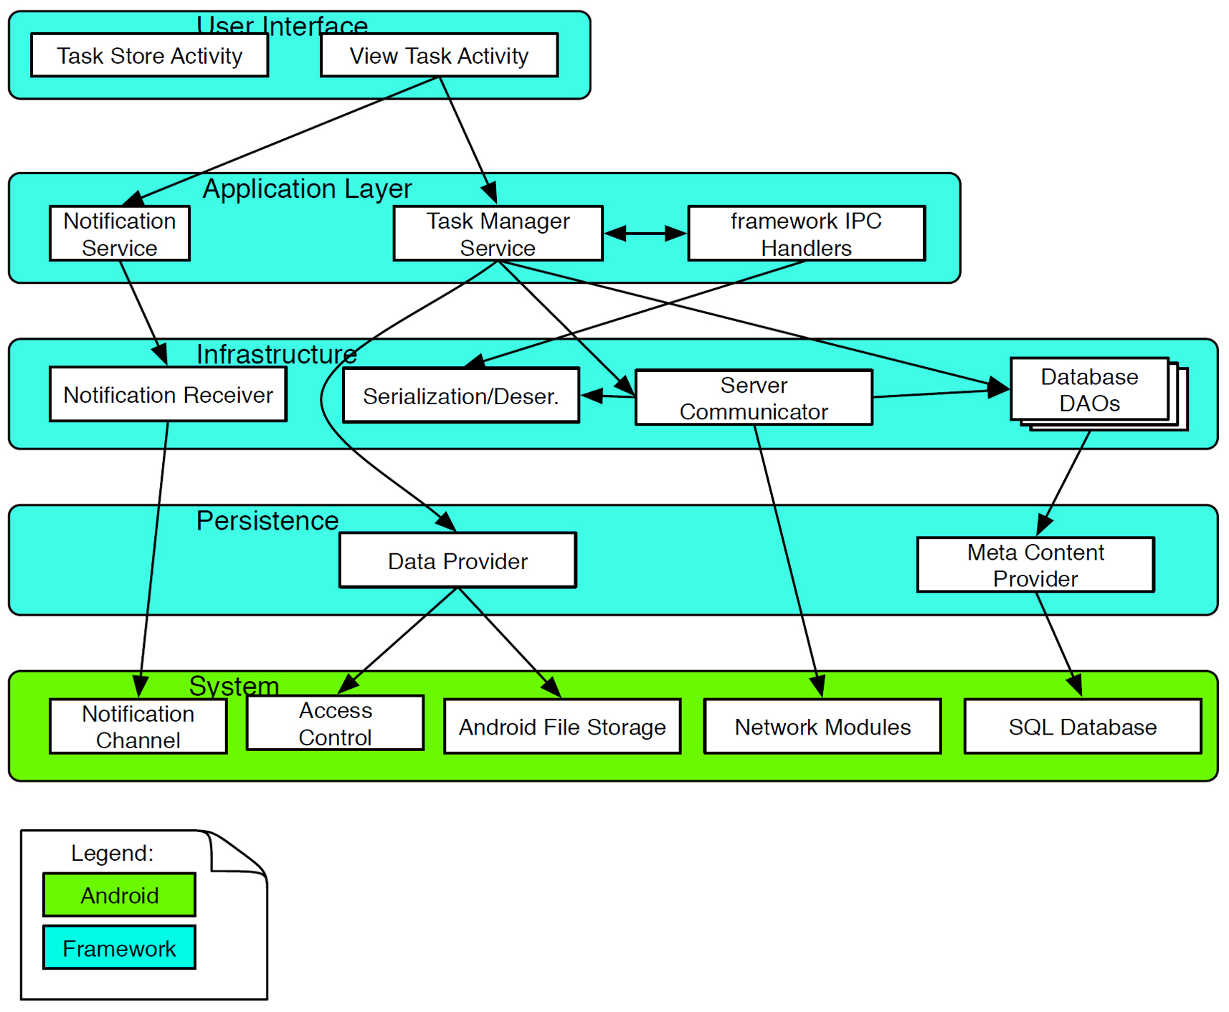
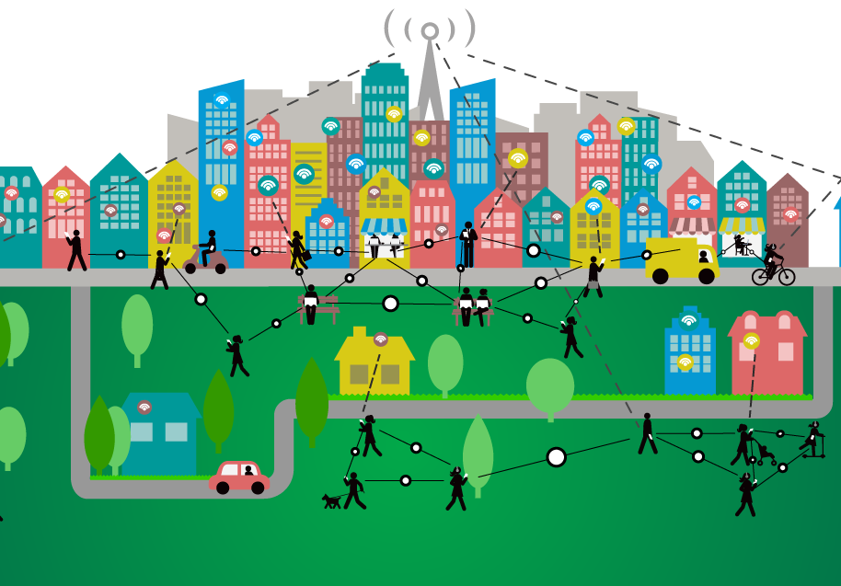
Smart City Surveillance Running On Vehicles
Alex Canner, Sam Canner, Ma’ayan Doron and Hongbo Liu
Purdue University School of Engineering
Indiana University-Purdue University Indianapolis
Abstract
Performance Evaluation
Develop smart city surveillance system using vehicles
Crowdsources real-time urban events
Utilizes vehicle-mounted cameras and GPS for accurate data
Upload data to database through cloud server
Data distributed to clients through cloud server
System performs with low wait times
System Design
The median wait times are similar as clients increase
As clients increase, the extremes become more polar
Completed Tasks
Critical Algorithms/Components
Task Data Model
Server accepts clients
Clients can submit queries
Server can access database
Database saves queries
Database saves information
Server can respond to clients
Can dictate vehicle target locations
Database sends data to clients
Retrieves vehicle locations
Customized User Query
Node.js’ asynchronicity
Mysql database interaction
Holds road conditions and vehicle locations
Timestamp algorithm
Keeps track of time the requests are made
Concurrent query handling
The server allows multiple clients to connect at once
Client Architecture
Future Work and References
Connect the server to vehicles
Connect server to android devices
Trajectory dictation
C. (2016, June 21). Smart City Illustration [Digital image]. Retrieved July 15, 2016, from http://www.geospatialworld.net/understanding-smart-city-solutions/
Pavlov, D. V., Dr., & Lupu, E., Dr. (2013). Hive: An Extensible and Scalable Framework For Mobile Crowdsourcing (Rep.). London: London Imperial College.
Smart City [Digital image]. (n.d.). Retrieved July 15, 2016, from images.google.com

